Slide 1

SFM and 3D reconstruction from scratch
Computer Vision 2023-2024
Authors: Giada Piacentini, Giada Troilo and Simone Cargnin

Slide 2
Outline
Introduction
Proposed methods
Dataset
Implementation details
Results
Conclusion and Future Works

Slide 3
Introduction
Create a 3D mesh from a 2D image

Slide 4
Introduction
Create a 3D mesh from a 2D image
Images
Different perspective
Sequential
RGB format

Slide 5
Introduction
Create a 3D mesh from a 2D image
Images
Different perspective
Sequential
RGB format
Camera calibration
Checkboard images
Calculate intrinsic parameters

Slide 6
Introduction
Camera calibration
Images
Cloud Point
3D meshes
Create a 3D mesh from a 2D image
Images
Different perspective
Sequential
RGB format
Camera calibration
Checkboard images
Calculate intrinsic parameters

Slide 7
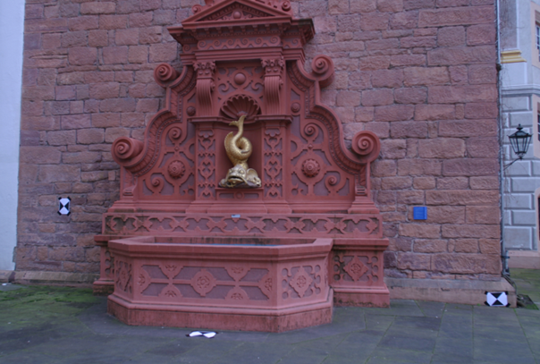
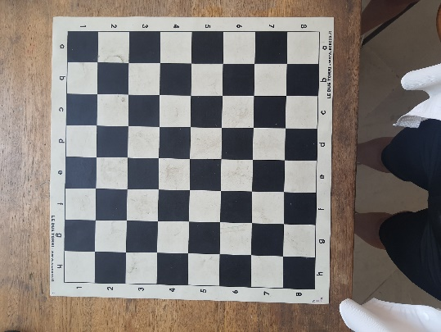

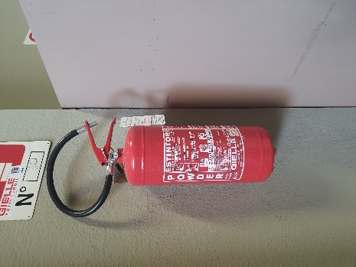
Proposed method:
CAMERA CALIBRATION
SFM
CLOUD
POINT
3D MESH
checkboard
object

Slide 8


Datasets
Benchmarking_Camera_Calibration_2008 Dataset
(Fountain-P11)
11 images
Intrinsic parameters of the camera
Dataset created by us
3 images
Checkboard images for cam. cal.

Slide 9

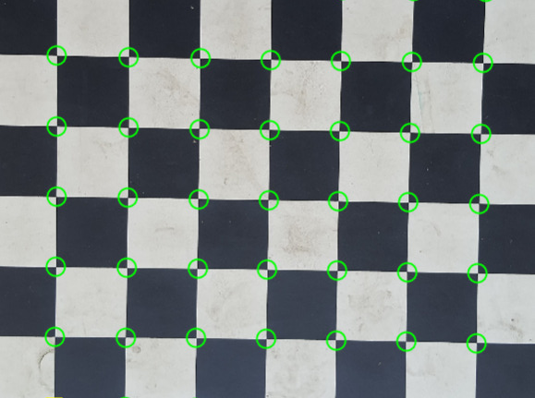
Camera calibration
Given:
10-15 photos of a checkboard
The size of the squares on the checkboard
We get the intrinsic parameters of the camera:
Focal lenght
Optical center of the camera
Projection matrix (k)
fx | 0 | cx
0 | fy | cy
0 | 0 | 1
Detected corners

Slide 10




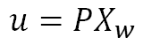
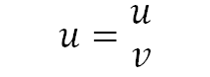
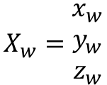
Camera calibration algorithm what is known?
u
3D coordinates in real-world
Extrapolated from the cell size
v
2D coordinates of the scene
$$X_{w}=\begin{matrix}x_{w} \\ y_{w} \\ z_{w}\end{matrix}$$
$$u=\begin{matrix}u \\ v\end{matrix}$$
z_{w}
$$u=PX_{w}$$
x_{w}
y_{w}

Slide 11
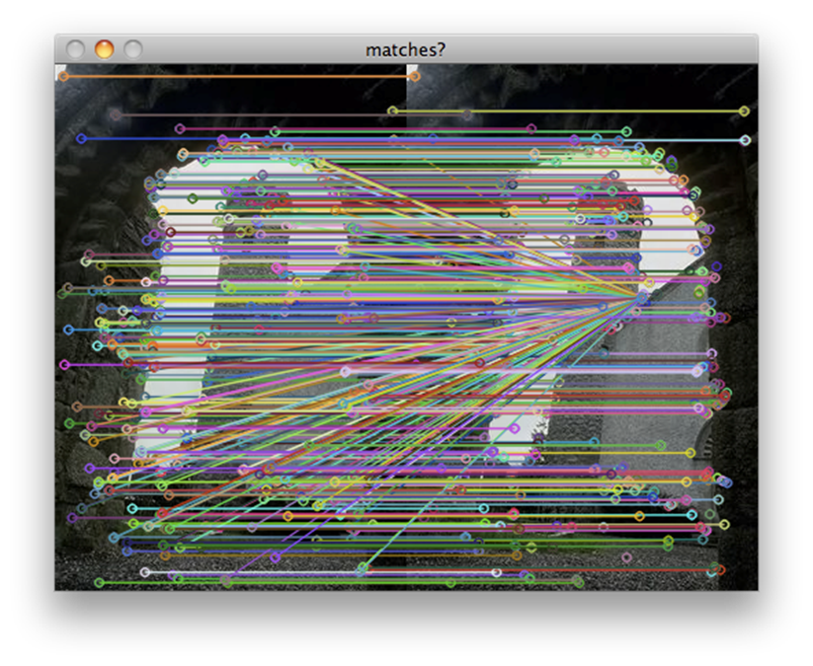

Camera calibration algorithm
How to find k
know
unknow
know
$$\left(\begin{aligned}u^{(i)} \\ v^{(i)} \\ 1\end{aligned}\right)=\left(\begin{matrix}p_{11} \\ p_{21} \\ p_{31}\end{matrix} \begin{matrix}p_{12} \\ p_{22} \\ p_{32}\end{matrix} \begin{matrix}p_{13} \\ p_{23} \\ p_{33}\end{matrix} \begin{matrix}p_{14} \\ p_{24} \\ p_{34}\end{matrix}\right)\left(\begin{aligned}x_{w}^{(i)} \\ y_{w}^{(i)} \\ z_{w}^{(i)} \\ 1\end{aligned}\right)$$
We solve it for P

Slide 12
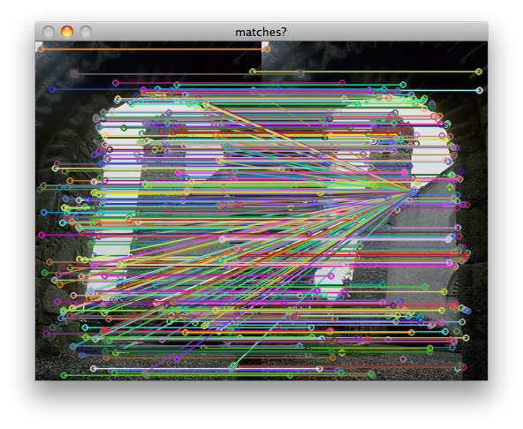
Feature extraction and mathing
Features are extracted using Sift algorithm
The matches are made using the sift descriptors
Matches are further refined using ransac algorithm to remove outliers

Slide 13
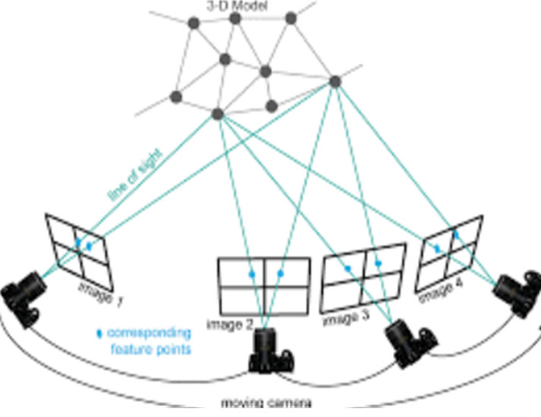
Feature extraction and mathing
Features are extracted using Sift algorithm
The matches are made using the sift descriptors
Matches are further refined using ransac algorithm to remove outliers

Slide 14
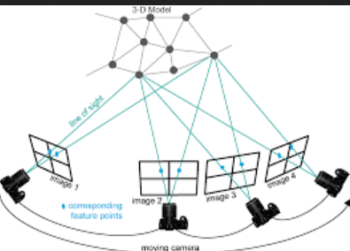
SFM - Steps
Camera pose estimation
2. Camera disambiguation
3. Triangulation

Slide 15
SFM – Camera pose estimation
Pnp -> Perspective n point algorithm
3D points
Pnp Ransac
Corresponding 2D
ESSENTIAL MATRIX
Intrinsic matrix K
Ransac is used to make the algorithm
more robust to outliers
Camera pose estimation
compute essential matrix using PnP ransac, estimate the object pose
2.camera disambiguation
3. Decomposition of the essential matrix in rotation and translation
4. Triangulation

Slide 16
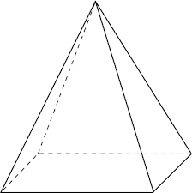

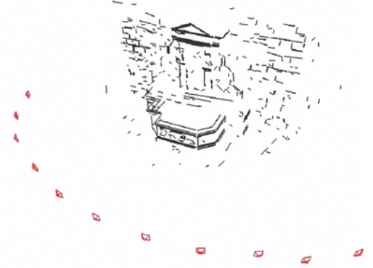

Camera disambiguation
Pnp algorithm can returns more than one solution
Pnp

Slide 17
Camera disambiguation
Pnp algorithm can returns more than one solution
Camera disambiguations is needed to choose the right one
Pnp
CAMERA DISAMBIGUATION

Slide 18
Camera disambiguation
Pnp algorithm can returns more than one solution
Camera disambiguations is needed to choose the right one
Pnp
CAMERA DISAMBIGUATION

Slide 19
Camera disambiguation
Pnp algorithm can returns more than one solution
Camera disambiguations is needed to choose the right one
In our project, we use PnP-RANSAC, which already handles camera disambiguation whit Ransac.
Pnp
RANSAC

Slide 20
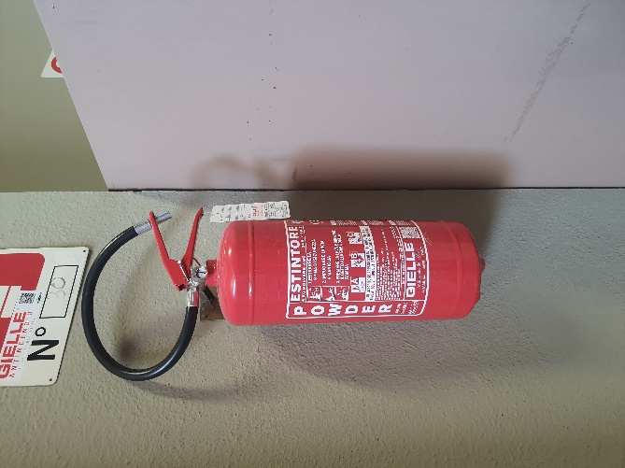
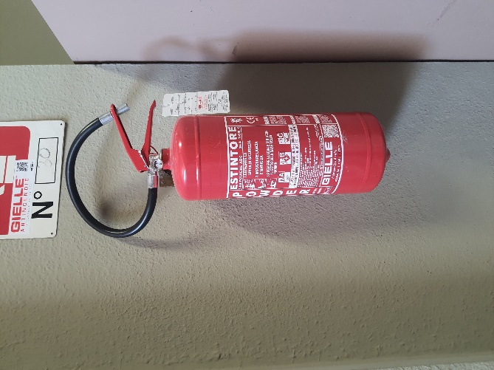
Triangulation
3D POINT
Left image
x
x’
Right image
C
C’
Left camera with matrix P
Right camera with matrix P’

Slide 21
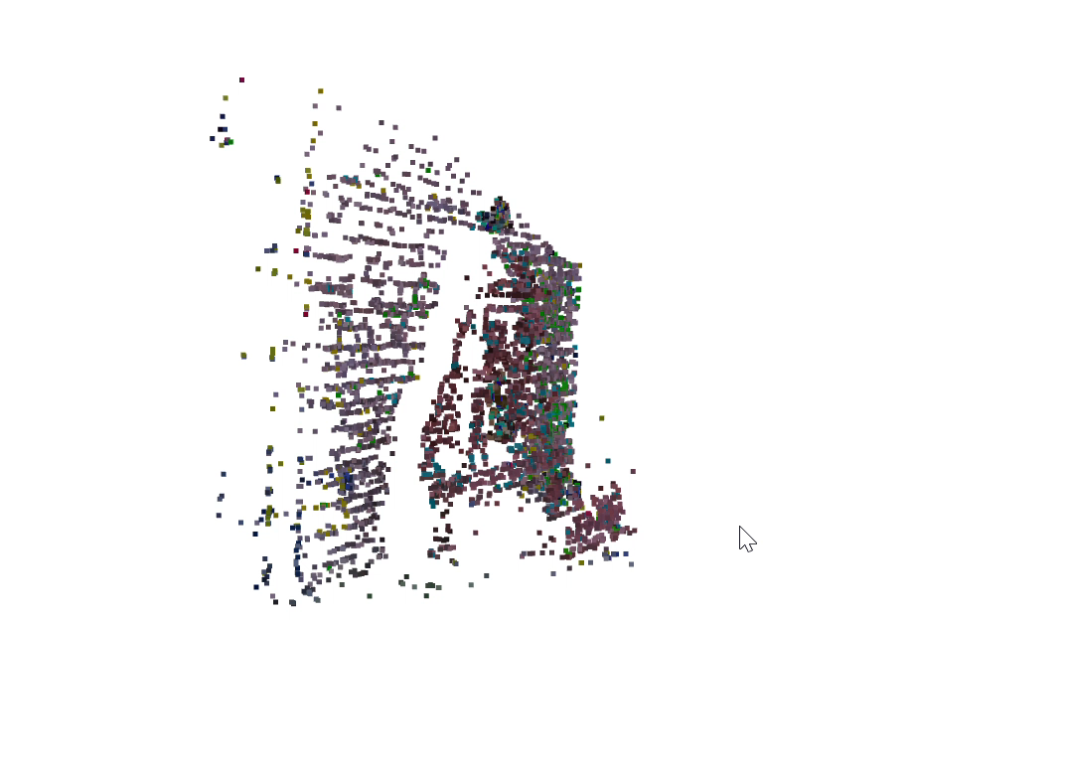

Results - Cloud Point
Fountain-P11

Slide 22
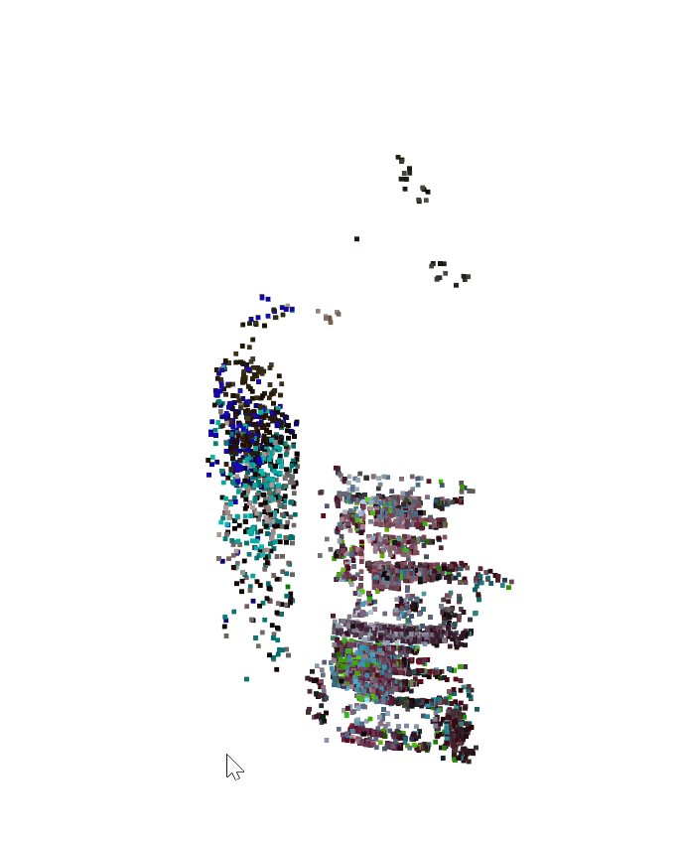
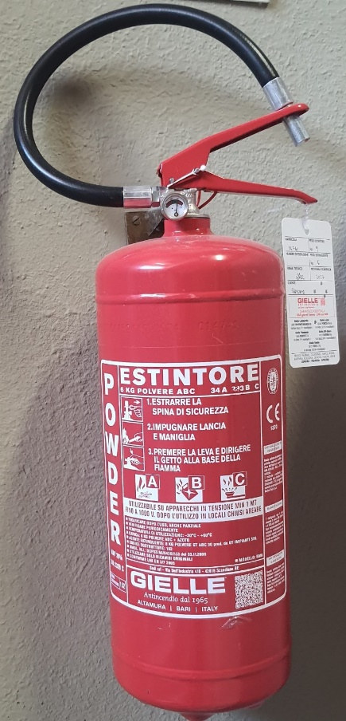
Results - Cloud Point
Fire extinguisher
from our dataset

Slide 23

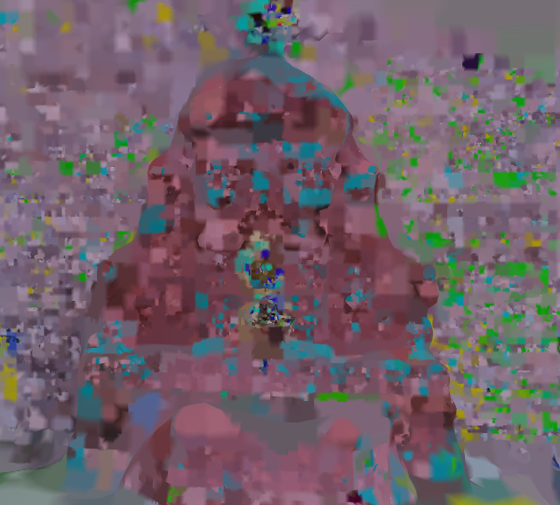
Results – 3D Mesh
For the reconstruction is used Poisson
This method produce smooth and continuous surface from noisy or incomplete cloud data
Fountain-P11

Slide 24
Conclusion and future works
Conclusion :
Analyzing our results, we can conclude that using more images leads to better performance. Objects with more details generate more keypoints, which in turn results in a higher quality point cloud.
Future works:
Optimize Triangulation: Use more sophisticated triangulation methods to improve the accuracy of 3D point computation.
Bundle Adjustment: Implement global and local bundle adjustment to refine the poses and 3D points. This step optimizes the entire reconstruction by minimizing the reprojection error across all images.

Slide 25


Authors
Piacentini Giada
piacentini.1907969@studenti.uniroma1.it
Troilo Giada
troilo.1889348@studenti.uniroma1.it
Cargnin Simone
cargnin.1940053@studenti.uniroma1.it

